Slide 1
Agenda
Session 3
Services
DI
Security
State
Unit Testing
Deployment
Debugging

Slide 2
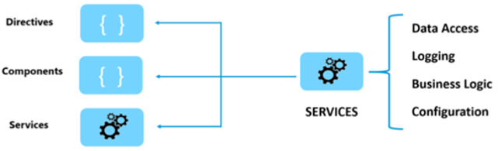
Services
Why Services?
Separation of Concerns
Sharing , reusable, discrete - functionality
Parts of service
Class
@Injectable Decorator
Provider
Services are just classes decorated with @Injectable, Instances are provided to injectors. Injectors deliver when needed.

Slide 3
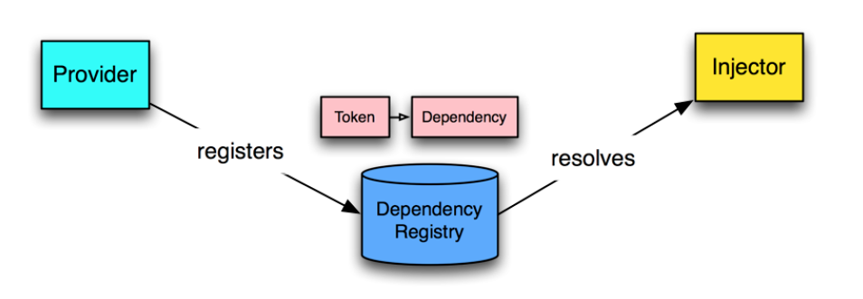
DI
The Angular DI framework consists of 4 concepts working together:
Token
This uniquely identifies something that needs to be injected. A dependency of code.
Dependency
The actual code that needs to be injected.
Provider
Maps a token (that can be a string or a class) to a list of dependencies. Provider tells Angular Injector how to create the service / an object, given a token.
Injector
This is a function which when passed a token returns/resolves a dependency (or list of dependencies) and injection them when creating objects.
Provider Recipes
UseClass
UseValue
UseFactory
UseExisting

Slide 4
Http
Consuming REST calls
Error Handling
Resolvers
Interceptors
Caching Http Requests
Testing

Slide 5
Security
Authentication
Authorization
Route Guards

Slide 6
Secure Coding

Slide 7
Unit Testing

